Slide 1
Week2
Vision Transformer & Vision-and-Language Transformer

Slide 2
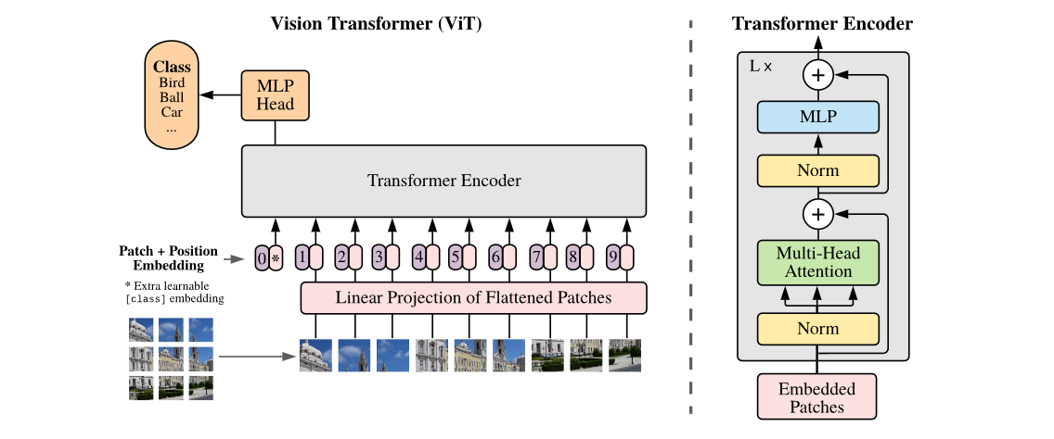
Vision Transformer
Image Procession & Linear Projection
Transformer Encoder
MLP Head

Slide 3
Image Procession & Linear Projection
Position Embedding
0
Class Token
*
1
2
Transformer Encoder
L
…
P
n
addition
image
patches
Linear Projection

Slide 4
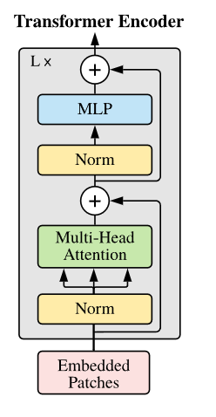
Transformer Encoder
Linear
There is different in ViT’s Transformer Encoder. In Encoder block, the Multi-Head Attention and MLP layer is after LayerNorm
Dropout
GeLU
Linear
MLP Layer

Slide 5
MLP Head
MLP Head just take the first output of Transformer Encoder as input(class token).
But in practice, usually use mean pooling on output.
MLP Head
Transformer Encoder
…

Slide 6
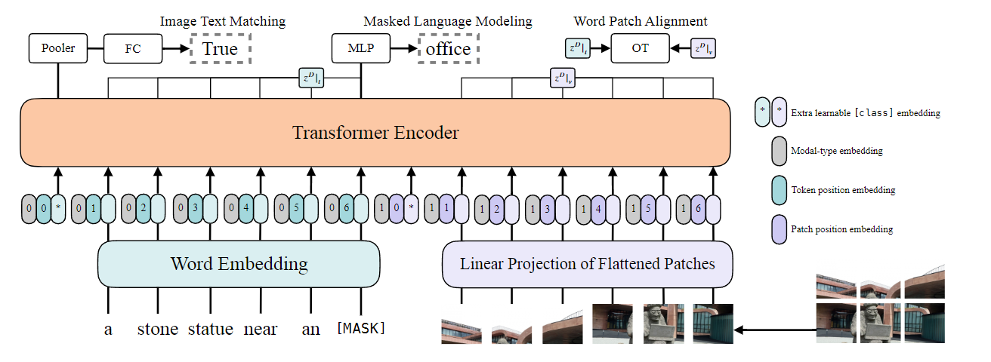
Vision-and-Language Transformer
Running time & Computational size
Loss computation
Inspired by Vision Transformer, Vision-and-Language Transformer(ViLT) directly using the Linear Projection Embedding on Words and Patches, and firstly remove convolutional vision embedder.

Slide 7
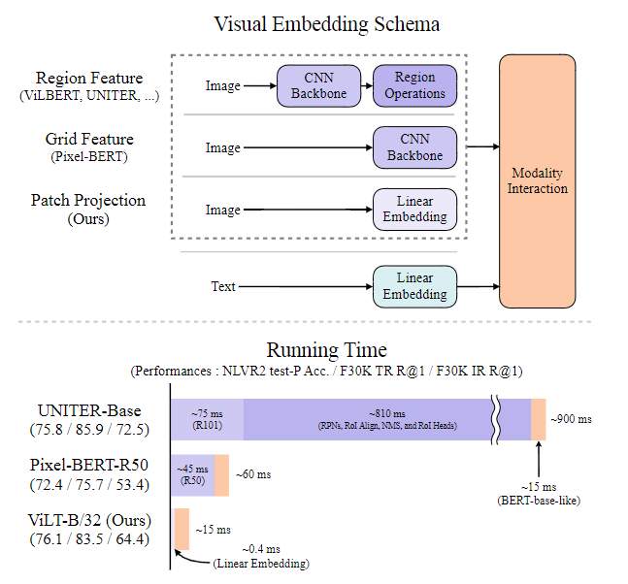
Running time & Computational size
The Embedding Schema and running time table show the Patch Projection is a simple way to embed visual patch and it can reduce running time from 900ms to 15ms, which the visual embedding schema take 810ms and 0.4ms.
Meanwhile, the performance of Patch Projection is between the Region Feature and Grid Feature, even overhaul the Region Feature on NLVR2.
The Patch Projection made the balance between running time and performance.

Slide 8
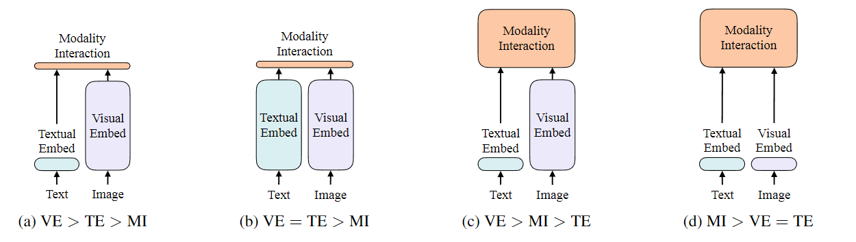
Running time & Computational size
Four categories of vision-and-language models. The height of each rectangle denotes its relative computational size. VE, TE, MI means visual embedder, textual embedder, modality interaction. The ViLT is category (d), which have equally and lightly computational size between VE and TE, and heavily computation on MI.

Slide 9
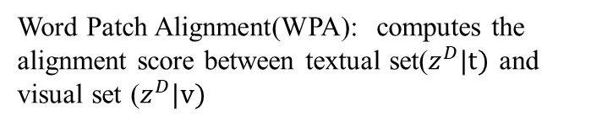
Loss computation
Masked Language Modeling(MLM): giving a pair of sentence and image, one word in sentence was masked, then the model output the masked word rely on other words in sentence and image, and computing the MLM loss for last.
Using negative log-likelihood
Image Text Matching(ITM): randomly replace image, and computing the ITM loss. The output of model just “True” of “False”.
Word Patch Alignment(WPA): computes the alignment score between textual set($z^{D}|t)$ and visual set ($z^{D}|v)$

